Slide 1

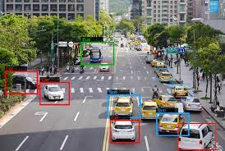
On the Performance of One-Stage and Two-Stage Object Detectors in Autonomous Vehicles Using Camera Data
Method
Introduction
Discussion
Team mets
Conclusion
Materials
Future works
Result
Background study

Slide 2
Team mates
17-35746-3 MD. AL-SAMIUL AMIN RISHAT
18-36807-1 Oishi Chowdhury
17-33586-1 Sonaly Akter
17-33356-1 Raffe,Al Shazid
Method
Introduction
Discussion
Conclusion
Materials
Future works
Result
Background study
Team mats
About

Slide 3
Introduction:
Autonomous vehicles have gotten a lot of press in recent years because of their potential to enhance road safety and traffic congestion. However, accurately perceiving the various traffic participants that interact with a vehicle remains a difficult issue.
In order to make intelligent driving judgments, these remote sensing systems must detect traffic targets in real time. Due to the high cost of LiDAR technology, camera-based solutions are becoming more common.
Modern detectors are usually classified into two groups (one-stage and two-stage). We have selected one-stage (RetinaNet, FCOS,YOLOv3) meta-architectures with different feature extractors.
Method
Discussion
Conclusion
Materials
Future works
Result
Background study
Team mats
Introduction
About

Slide 4
Background Study: The development of deep learning-based techniques has resulted in substantial advancements in computer vision over the previous decade. Researchers have been able to create incredibly deep convolutional neural networks, which have shown to be the most successful approach for extracting usable information from images.CNNs have also become the standard method for object detection in the literature.
This can be classified into two categories:
two-stage detectors and one-stage detectors. Two-stage detectors, on average, achieve higher accuracy at a higher computational cost than one-stage detectors. This fact, however, is extremely dependent on the convolutional backbone network used and the hyper parameter setting, which is a complex procedure.
The bounding boxes and object categorization are directly provided by a single feed-forward fully convolutional network in one-stage detectors.The Single Shot MultiBox Detector (SSD) and YOLO (You Only Look Once) were among the first to offer a unified design that did not require a per-proposal computation. YOLO detectors, which divide the image into regions and forecast bounding boxes and probability for each zone. Although not as accurate as RetinaNet, YOLO networks have shown to attain faster inference rates.
Method
Background study
Discussion
Conclusion
Materials
Future works
Result
Team mats
Introduction
About

Slide 5
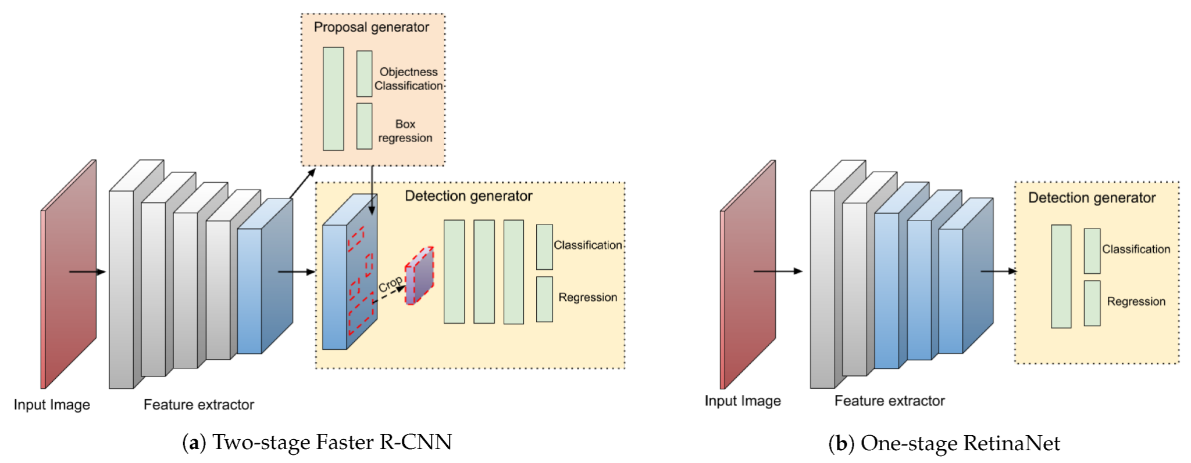
Materials and Methods
Waymo Open Dataset
Deep Learning Meta-Architectures
Faster R-CNN
RetinaNet
YOLOv3
FCOS
Discussion
Conclusion
Future works
Method
Team mats
Result
Materials
Introduction
Background study
About

Slide 6
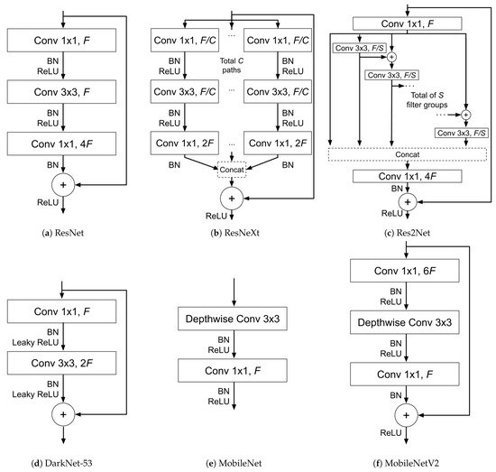
Materials and Methods
Feature Extractors
ResNet, ResNeXt, and Res2Net
DarkNet
MobileNet
Training Procedure and Other Implementation Details
Discussion
Method
Conclusion
Future works
Result
Materials
Team mats
Introduction
Background study
About

Slide 7
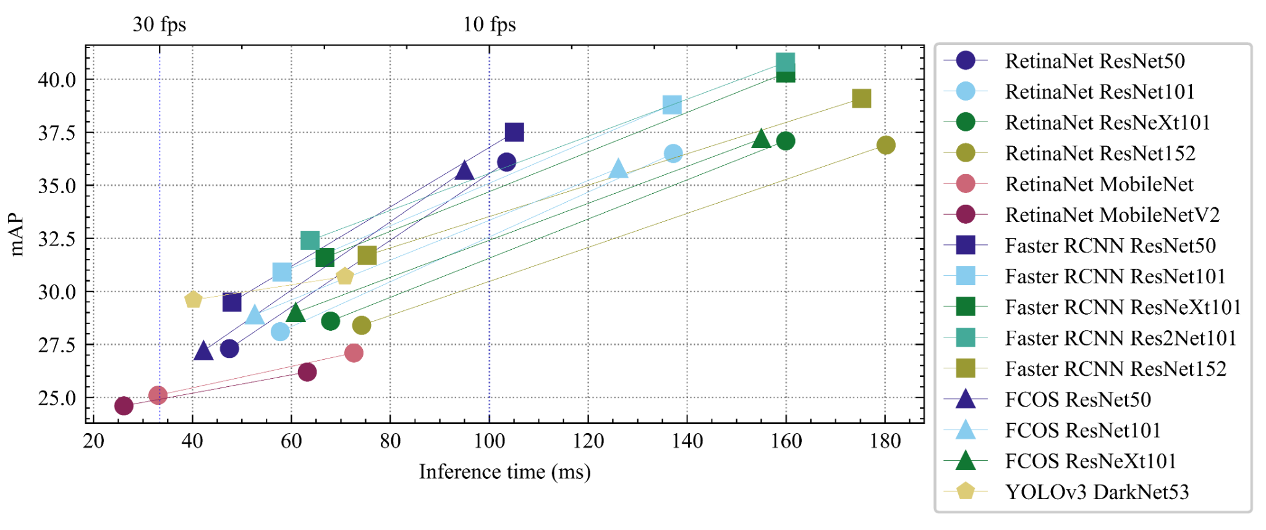
Results and Discussion
All the experiments were performed on the same machine and with the same configuration in order to report comparable time results. We used a computer with an Intel i7-8700 CPU and an NVIDIA GeForce RTX 2080Ti 12GB GPU.
Evaluation metrics
Precision and efficiency analysis
COCO
waymo
Discussion
Conclusion
Future works
Result
Team mats
Method
Materials
Introduction
Background study
About

Slide 8
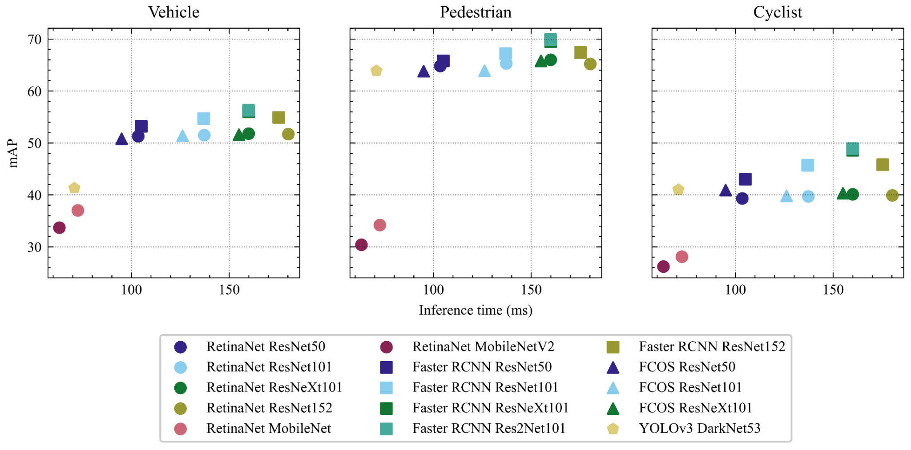
Results and Discussion
Effectiveness of transfer learning
Other useful metrics
Conclusion
Future works
Result
Team mats
Method
Discussion
Materials
Introduction
Background study
About

Slide 9
Conclusions
The most accurate detection models were obtained using high-resolution images and do not reach real-time speed. Therefore, in this context, it is necessary to sacrifice some accuracy by using smaller input images to improve the inference rate.
Faster R-CNN using Res2Net-101 obtains the best speed/accuracy trade-off but needs lower resolution images to achieve real-time inference speed.
Two-stage Faster R-CNN models can achieve speeds comparable to one-stage detec- tors with higher detection accuracy.
The anchor-free FCOS detector is a slightly faster one-stage alternative to RetinaNet, with similar precision and lower memory usage.
RetinaNet MobileNet is the only model reaching 30 FPS, but with low precision. YOLOv3 or FCOS ResNet-50 at 25 FPS are more convenient options for on-board applications, although not as accurate as Faster R-CNN.
Increasing the image resolution significantly degrades the computational efficiency of RetinaNet models with ResNet backbones, hence becoming impractical for this application.
One-stage models fail to achieve good results over the minority class in this problem. Faster R-CNN models proved to be more robust to the presence of imbalanced data.
Conclusion
Team mats
Result
Method
Future works
Discussion
Materials
Introduction
Background study
About

Slide 10
Future Work:
Future work should be focused on the study of new paradigms for object detection such as the use of transformers or lambda networks. These novel models have achieved promising results in general computer vision tasks and should be validated in the autonomous vehicle domain.
Further research should also analyze options to improve data quality by fusing cam- era data with sensors such as LiDAR. The community would benefit from novel approaches on how to combine the information of multi-modal sensors without damaging inference speed.
Have to address the particularities presented in autonomous-vehicle data.
Need more in-depth studies such as the high imbalance between classes and the overlapping of small objects.
More context-specific network architectures should be developed, together with more powerful transfer learning approaches.
The object detection problem could potentially benefit from using temporal information across consecutive frames.
Therefore, next studies should evaluate the models with an online approach, respecting the order of frames in the video recorded by the on-board cameras of the vehicle.
Conclusion
Team mats
Result
Method
Discussion
Materials
Future works
Introduction
Background study
About

Slide 11
Thank you
Conclusion
Future works
Result
Team mats
Method
Discussion
Materials
Introduction
Background study
About

